Slide 1
Normalization
1 2 3 NF
Notes:
1
The slides for this text are organized into chapters. This lecture covers Chapter 19, on formal, dependency-driven database design..
Integrity constraints, in particular functional dependencies, play an important role in the design of database schemas. In particular, they can shed light on potential redundancies (and the problems that go with redundancy) in a relational schema. Typically, they are used to analyze the relational schema obtained by converting an ER diagram.
This chapter can be covered any time after the Foundations material (Chapters 1 to 5) is covered, at the instructor’s discretion. A good choice is to cover it after presenting all the implementation related material that is included in a course. This will allow a design sequence consisting of Chapters 19 and 20, and will enable the instructor to bring out the fact that design involves both redundancy analysis and performance considerations, and that these concerns should go hand-in-hand.

Slide 2
Functional Dependencies
  α → β is trivial if β ⊆ α

Slide 3
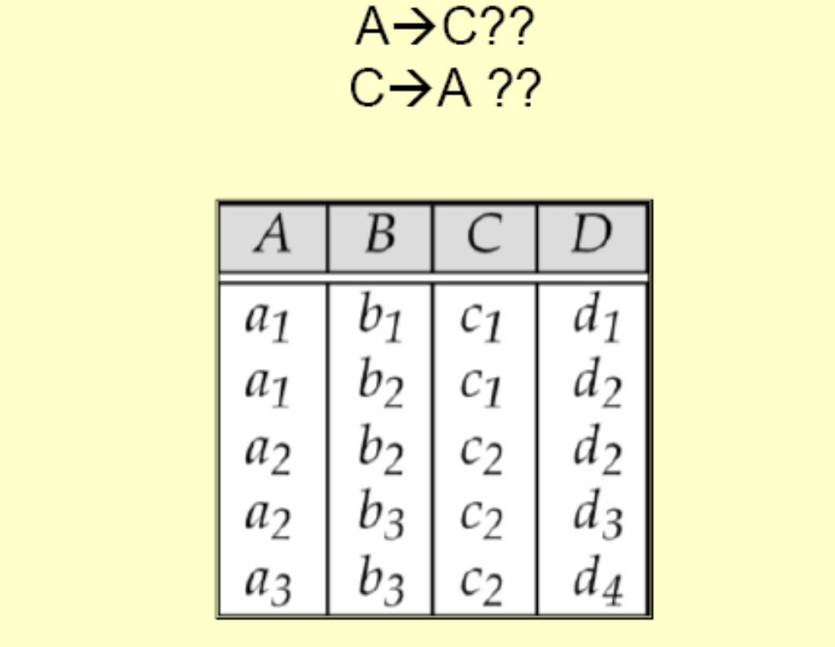
Functional Dependency

Slide 4
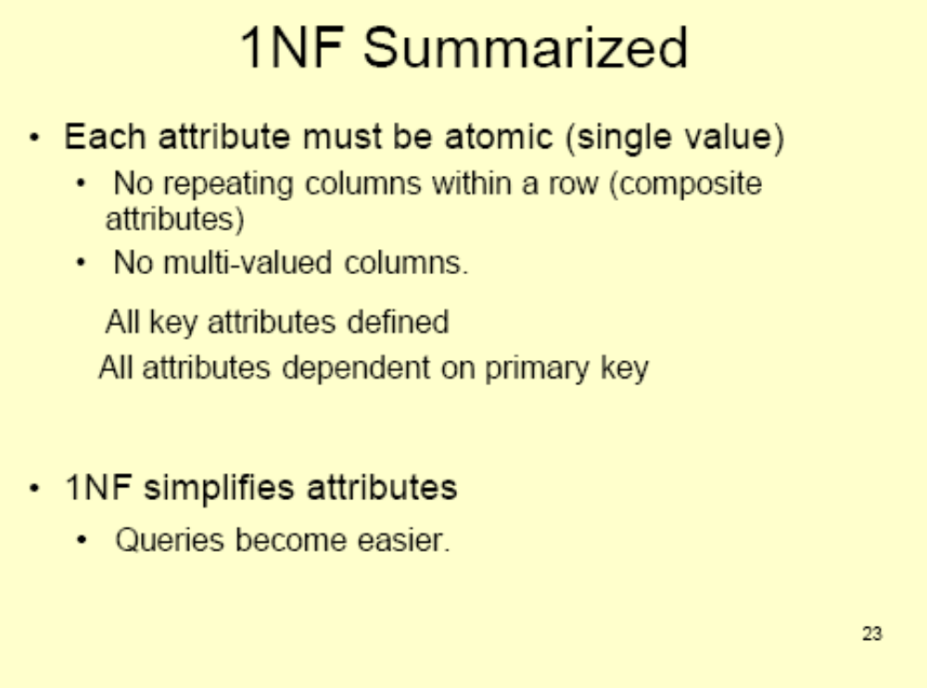

Slide 5
Dependencies and Normal Form
The schema R is in 1NF if domain of all attributes of R is atomic
Desirable
  PK dependencies
Undesirable
  Partial Key : based on part of composite PK
  Transitive: one nonprime attribute depends on another nonprime attribute

Slide 6
Normal Forms
Scalar Values
  1 NF
Normal Forms based on PK
  2 NF
  3 NF
Normal Forms based on CKs
  Boyce-Codd Normal Form (BCNF)
Other Normal Forms
  4 NF (Multivalued Dependencies)
  5 NF (Join Dependencies)
  Deal with very rare practical situations

Slide 7
Normal Forms
1NF : A relation is in a first normal form, if every tuple contains exactly one value for each attribute
Example: Suppliers1 ( S# , status, city, P# , qty)
Primary key ( S#, P#)
City→ status (FD)
FD Diagram (FDD) can be drawn
Observe
    Status depends on the city (FD)
    City depends only on the supplier number

Slide 8
Redundancies in Suppliers1
Insert: We cannot insert the fact that a particular supplier is located in the city unless he/she actually supplies some part
The Suppliers1 may not show a supplier is located in Chennai
Delete: If we delete a sole Suppliers1 tuple for a particular supplier, we also delete that he/she is located in a particular city
Update: to update the city for a particular supplier

Slide 9
Schema Refinement for Suppliers1
Refined Schema
  Suppliers2 ( S#, status, city)
  Suppliers_Parts ( S#, P#, qty)
Insert: We can insert the info that s-5 is located in Pune although s-5 does not currently supply any part
Delete: We do not lose the info that s-18 is located in Surat
even if all the s-18 tuples from the suppliers_parts are deleted
Update: city for a supplier can be updated easily through suppliers2

Slide 10
Second Normal Form 2NF
A relation is in 2NF only if it is in 1NF and every nonkey attribute is irreducibly dependent on the primary key.
(here, we are assuming only single candidate ( hence primary ) key case)
The original relation Suppliers1 can be converted to the 2NF form by taking projection of it to a set of 2 relations suppliers2 and suppliers_parts
All relations with single attribute PK are in 2 NF!!
2NF applies to relations with composite keys

Slide 11
2 NF
A relation that is in 1NF & every non-PK attribute is fully dependent on the PK, is said to be in 2 NF
Remove all Partial Dependencies
1 NF
2 NF

Slide 12
2NF Problems: Suppliers2
Insert: we cannot insert the fact that a particular city has a particular status unless we have some supplier located in that city
Delete: if we delete a sole tuple for a particular city we delete the information for the supplier and also the information that a city has a particular status
Update: the status for a city appears many a times in the suppliers2. The change in the Mumbai status from 80 to 90 may need changes in 100 tuples

Slide 13
Schema Refinement for Suppliers2
Replace Suppliers2 by
  Suppliers3 ( S#, city )
  City_Info ( city, status)
3NF : A relation is in a 3NF if it is in 2NF and every nonkey attribute is notransitively dependent on the primary key
A relation is in a 3NF if nonkey attributes are:
  Mutually independent
  Irreducibly/nontransitively dependent on the primary key
A nonkey attribute is any attribute that does not participate in the primary key of that relation

Slide 14
3 NF
A relation that is in 1NF & 2 NF & no non-PK attribute is transitively dependent on the PK, is said to be in 3 NF
2 NF
Remove all
Transitive Dependencies
3 NF

Slide 15
Heath’s Theorem
R(A,B,C) where A B C are sets of attributes
If R has FD A --> B, then R equals join of {A B} and {A C}
Example:
S ( s#, status, city) ;
PK: s# implies s# --> city and s# --> status
FD: City --> status is troublesome ( out of non-candidate key)
Then decomposition
(s#,city), (status, city) is Dependency Preserving

Slide 16
Heath’s Theorem
it says that a relation R over an attribute set U and satisfying a functional dependency X → Y can be safely split in two relations having the lossless-join decomposition property, namely into
where Z = U − XY are the rest of the attributes.
functional dependency provides a simple way to construct a lossless-join decomposition of R in two smaller relations

Slide 17

Normal Forms
Returning to the issue of schema refinement, the first question to be asked is whether any refinement is needed!
If a relation is in a certain normal form (BCNF, 3NF etc.), it is known that certain kinds of problems are avoided/minimized. This can be used to help us decide whether decomposing the relation will help.
Role of FDs in detecting redundancy:
  Consider a relation R with 3 attributes, ABC.
    No FDs hold: There is no redundancy here.
    Given A B: Several tuples could have the same A value, and if so, they’ll all have the same B value!
Notes:
22

Slide 18
Boyce-Codd Normal Form BCNF (1974)
2 or more candidate keys
Composite candidate keys
Overlapped keys
A relation is in BCNF if and only if only determinants are candidate keys

Slide 19
BCNF
Based on FDs that take into account all candidate keys of a relation
For a relation with only 1 CK, 3NF & BCNF are equivalent
A relation is said to be in BCNF if every determinant is a CK

Slide 20
BCNF
Relation Suppliers1 ( s#, status, city, p#, qty) is not in BCNF. It has 3 determinants s#, city and (s#,p#)
Relation Suppliers2( s#, status, city) is not in BCNF. It has s# and city as determinants
But SP (s#,p#,qty), SC (s#,city) and CS ( city,status) are in BCNF

Slide 21
Contd…
Nonoverlapping candidate keys
  S( s#,sname,city ,status)
  S# and sname are candidate keys and city->status no longer holds
  S is in BCNF
Overlapping candidate keys
  SSP( s#,sname, p#,qty) is not in BCNF
  S#->sname and viceversa prevents it to be in BCNF
  Redudndancies: same supplier,name pair repeated for various parts that the supplier is supplying
  SS(s#,sname) , SP( s#,p#,qty)

Slide 22
Decomposition of a Relation Scheme
Suppose that relation R contains attributes A1 ... An. A decomposition of R consists of replacing R by two or more relations such that:
Each new relation scheme contains a subset of the attributes of R (and no attributes that do not appear in R), and
    Every attribute of R appears as an attribute of one of the new relations.
Intuitively, decomposing R means we will store instances of the relation schemes produced by the decomposition, instead of instances of R.
E.g., Can decompose SNLRWH into SNLRH and RW.
Notes:
26

Slide 23

Example Decomposition
Decompositions should be used only when needed.
  SNLRWH has FDs S SNLRWH and R W
  Second FD causes violation of 3NF; W values repeatedly associated with R values. Easiest way to fix this is to create a relation RW to store/preserve these associations, and to remove W from the main schema:
    i.e., we decompose SNLRWH into SNLRH and RW
The information to be stored consists of SNLRWH tuples. If we just store the projections of these tuples onto SNLRH and RW, are there any potential problems that we should be aware of?
Notes:
27

Slide 24
Lossless Decomposition
Theorem
A decomposition of R into R1 and R2 is lossless join wrt FDs F, if and only if at least one of the following dependencies is in F⁺:
  R1 ∩ R2 → R1
  R1 ∩ R2 → R2
In other words, R1 ∩ R2 forms a superkey of either R1 or R2
Optionally you can infer about a decomposition by actually checking joins of the decomposed relation instances
Notes:
28

Slide 25
Boyce-Codd Normal Form
A relation schema R is in BCNF with respect to a set F of functional dependencies if for all functional dependencies in F⁺ of the form
α → β
where α ⊆ R and β ⊆ R, at least one of the following holds:
  α → β is trivial (i.e., β ⊆ α)
  α is a superkey for R

Slide 26
Boyce-Codd Normal Form (Cont.)
Example schema that is not in BCNF:
in_dep (ID, name, salary, dept_name, building, budget )
because :
  dept_name→ building, budget
    holds on in_dep
    but
  dept_name is not a superkey
When decompose in_dept into instructor and department
  instructor is in BCNF
  department is in BCNF

Slide 27
Decomposing a Schema into BCNF
Let R be a schema R that is not in BCNF. Let α →β (nontrivial where α is not a superkey ) be the FD that causes a violation of BCNF.
We decompose R into:
  (α U β )
  ( R - ( β - α ) )
In our example of in_dep,
  α = dept_name
  β = building, budget
  and in_dep is replaced by
  (α U β ) = ( dept_name, building, budget )
  ( R - ( β - α ) ) = ( ID, name, dept_name, salary )

Slide 28

Example
R = (A, B, C)
F = {A → B, B → C)
R₁ = (A, B), R₂ = (B, C)
  Lossless-join decomposition:
  R₁ ∩ R₂ = {B} and B → BC
  Dependency preserving
R₁ = (A, B), R₂ = (A, C)
  Lossless-join decomposition:
  R₁ ∩ R₂ = {A} and A → AB
  Not dependency preserving
  (cannot check B → C without computing R₁ R₂)

Slide 29
BCNF and Dependency Preservation
database consistency constraints: primary-key constraints, functional dependencies, check constraints, assertions, and triggers.
It is not always possible to achieve both BCNF and dependency preservation
Consider a schema:
dept_advisor(s_ID, i_ID, department_name)
With function dependencies:
i_ID → dept_name
s_ID, dept_name → i_ID
dept_advisor is not in BCNF
  i_ID is not a superkey.
Any decomposition of dept_advisor will not include all the attributes in
s_ID, dept_name → i_ID
Thus, the composition is NOT be dependency preserving

Slide 30
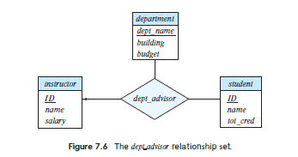
Dependency Preservation

Slide 31
Third Normal Form
A relation schema R is in third normal form (3NF) if for all:
α → β in F⁺
at least one of the following holds:
  α → β is trivial (i.e., β ∈ α)
  α is a superkey for R
  Each attribute A in β – α is contained in a candidate key for R.
  (NOTE: each attribute may be in a different candidate key)
If a relation is in BCNF it is in 3NF (since in BCNF one of the first two conditions above must hold).
Third condition is a minimal relaxation of BCNF to ensure dependency preservation (will see why later).

Slide 32
3NF Example
Consider a schema:
dept_advisor(s_ID, i_ID, dept_name)
With function dependencies:
i_ID → dept_name
s_ID, dept_name → i_ID
Two candidate keys = {s_ID, dept_name}, {s_ID, i_ID }
We have seen before that dept_advisor is not in BCNF
R, however, is in 3NF
  s_ID, dept_name is a superkey
  i_ID → dept_name and i_ID is NOT a superkey, but:
    { dept_name} – {i_ID } = {dept_name } and
    dept_name is contained in a candidate key

Slide 33

Redundancy in 3NF
Consider the schema R below, which is in 3NF
What is wrong with the table?
  R = (J, K, L )
  F = {JK → L, L → K }
  And an instance table:
  Repetition of information
  Need to use null values (e.g., to represent the relationship l₂, k₂
  where there is no corresponding value for J)

Slide 34
Comparison of BCNF and 3NF
Advantages to 3NF over BCNF. It is always possible to obtain a 3NF design without sacrificing losslessness or dependency preservation.
Disadvantages to 3NF.
  We may have to use null values to represent some of the possible meaningful relationships among data items.
  problem of repetition of information.

Slide 35
Goals of Normalization
Let R be a relation scheme with a set F of functional dependencies.
Decide whether a relation scheme R is in “good” form.
In the case that a relation scheme R is not in “good” form, need to decompose it into a set of relation scheme {R₁, R₂, ..., R_{n}} such that:
  Each relation scheme is in good form
  The decomposition is a lossless decomposition
  Preferably, the decomposition should be dependency preserving.

Slide 36
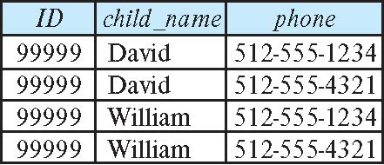
How good is BCNF?
There are database schemas in BCNF that do not seem to be sufficiently normalized
Consider a relation
inst_info (ID, child_name, phone)
  where an instructor may have more than one phone and can have multiple children
  Instance of inst_info

Slide 37
How good is BCNF? (Cont.)
There are no non-trivial functional dependencies and therefore the relation is in BCNF
Insertion anomalies – i.e., if we add a phone 981-992-3443 to 99999, we need to add two tuples
(99999, David, 981-992-3443)
(99999, William, 981-992-3443)

Slide 38
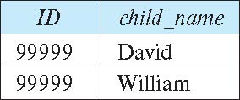
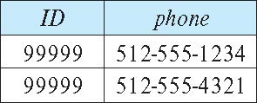
Higher Normal Forms
It is better to decompose inst_info into:
  inst_child:
  inst_phone:
This suggests the need for higher normal forms, such as Fourth Normal Form (4NF), which we shall see later

